Slide 1




Supervisor-led Studentships Q&A
Open Collaborative & Steers Competitions
Supporting, delivering and facilitating high quality opportunities and training by engaging with students, staff and partners to positively impact the social science community in Scotland
From SGSSS: Professor Alan Marshall, Deputy Director for Studentships and Partnerships
Notes:
Introductions – who you are, which institution you're from, role in SGSSS

Slide 2
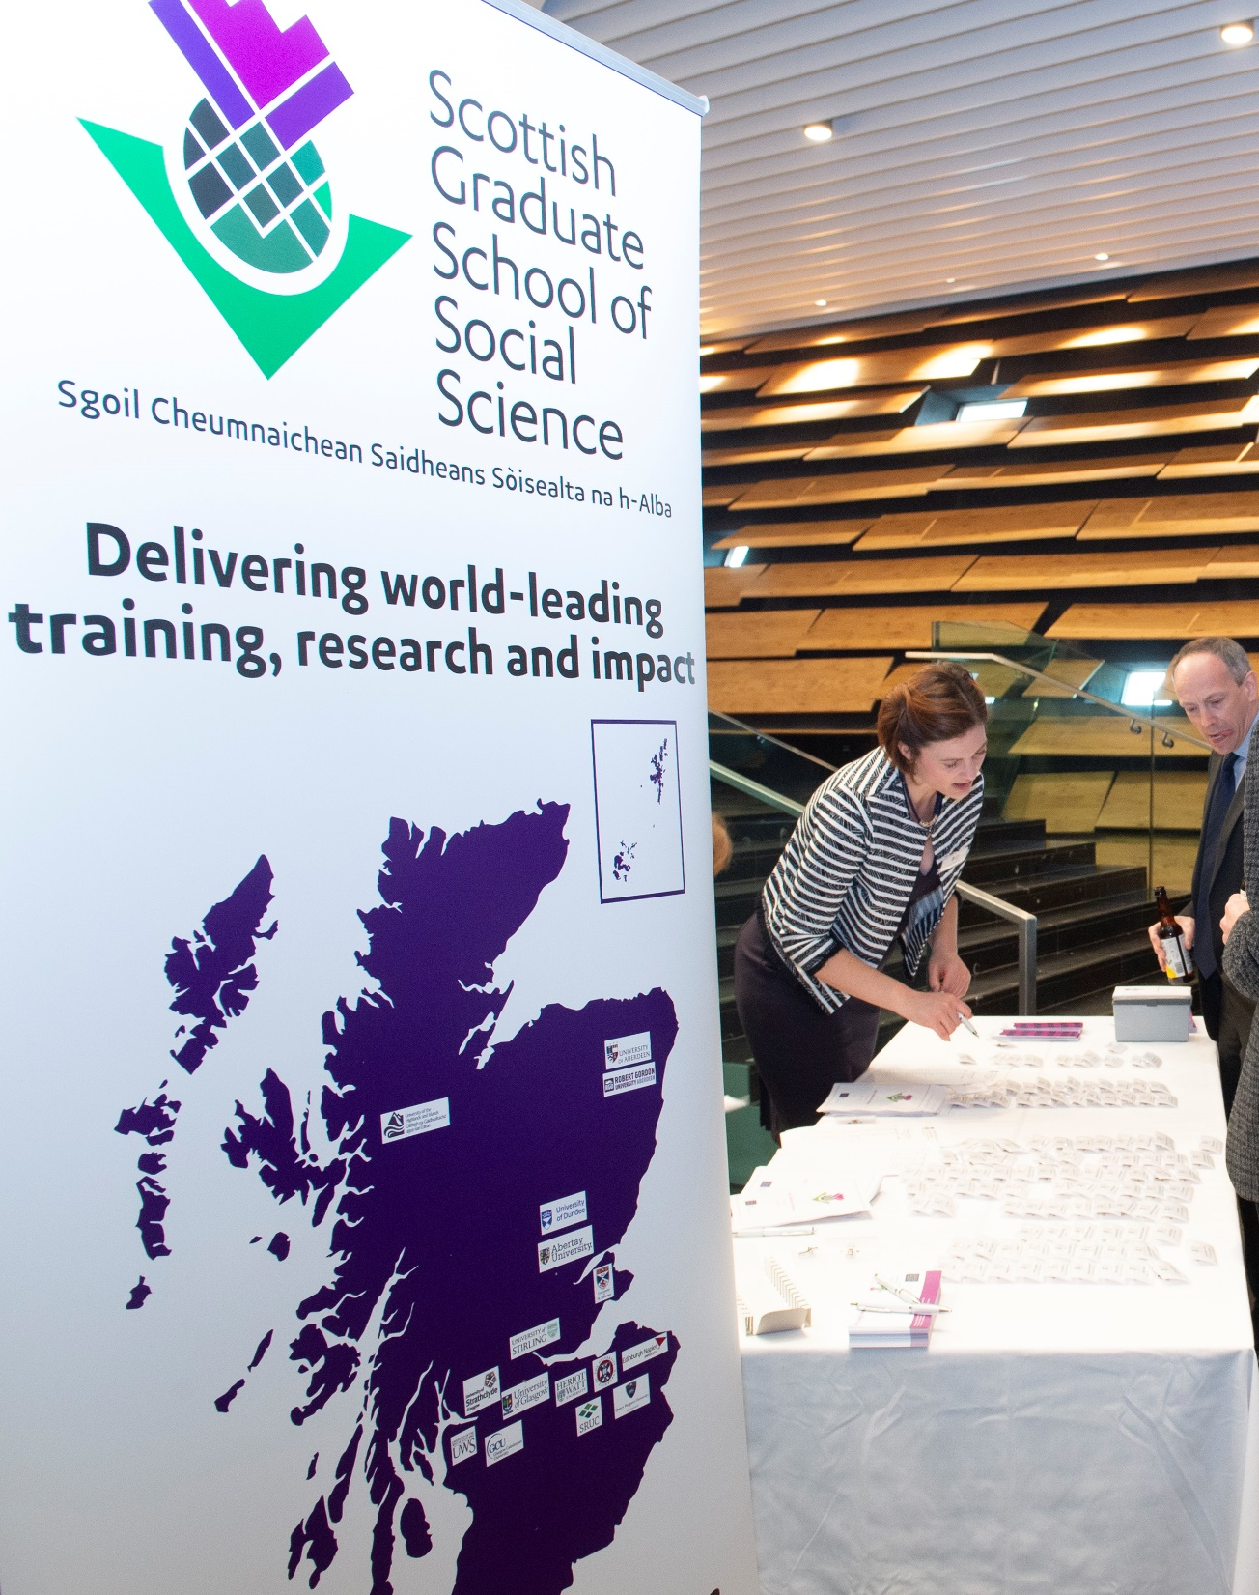
What will we cover?
A brief introduction to DTP2 and its implications for supervisors
An introduction to steers and collaborative Competitions and Timelines.
Tips for funding
Time for Q&A (use the chat function too)

Slide 3
Supervisor-led Studentships
Key changes in DTP2
Major change in ESRC Completion Policy for students commencing from October 2024: completion within the funded period.
  Risk assessment and feasibility key in devising, assessing and implementing research proposals
The length of the standard PhD has increased to 3.5 years in recognition of ESRC expectations that students will undertake a 3ms placement (more later) and 3 months for additional new training required by the ESRC. All studentships must be offered as 1+3.5 or +3.5 awards. (A reminder that all studentships must be offered as full-time or part-time opportunities).
Eligibility for first supervision - First supervisors need to be research-active social scientists who are aligned to a UoA for which their institution has eligibility. SGSSS (and ESRC) will audit supervisor eligibility carefully. For more on eligibility criteria, visit this page.

Slide 4
Supervisor-led Studentships
Key changes as we move into DTP2
Move to challenge-led pathways: each applicant must select a challenge-led pathway within which their student will sit.
Communication, AI, and New Technologies​ | Environment, Migration, and Demographic Change​
Governance and Institutions​ | Health, Wellbeing and Communities ​
Securities: Justice, Economies, and Conflict​ | Social Inequalities​

Slide 5
Supervisor-led Studentships
Introducing “Research in Practice”
Through Research in Practice, SGSSS seeks to equip ESRC funded students to be confident collaborating across sectors and disciplinary boundaries.
The placement must be separate to the PhD student’s research and be designed to support their researcher development, sector knowledge and transferable skills.
Students must undertake the placement in the second or third year of their PhD study, with more than 3 months remaining before their funding end date.
Placements can take place within academia or outside academia.
Academic placements must not be undertaken with the student’s current supervisor and/or research team
Placements must provide opportunity to apply their research skills in new environments
Students will discuss placement plans with their supervisor team and SGSSS at the Development Needs Analysis.
SGSSS must approve all placement proposals in advance to confirm that they meet the placement requirements.
For more on placements, click here.

Slide 6
Supervisor-led Studentships
Key notes for new supervisors
In 2021 we introduced a new element to our marking Framework – the Whole Person Approach – all successful applicants to our supervisor led competitions will be expected to use this in recruiting students – you will receive guidance on this following our panel decisions.
In 2020 the ESRC changed its recruitment policy on international students – we are now able to recruit international students up to a maximum of 30% of our total allocation. This is complex to implement across competitions and so successful supervisors will receive guidance on recruitment.

Slide 7
Supervisor-Led Competitions (Steers)
Dates for your diary
• 19 August 2026: All Steers competitions go live
• 23 September 2026: Deadline for Stage 1 Applications for Steers
• 19 October 2026: Stage 1 outcome announced
• 16 November 2026: Deadline for Stage 2 Applications for Steers
• 9 February 2027: outcomes announced
Steers Competition
Approximately 3 awards in each of the following steers (9 in total):
• Advanced Quantitative Methods (Advanced quantitative methods for discipline)
• Data Sets (see guidance on SGSSS website on eligible data)
• Interdisciplinary (cross-Research council)
Please note institutions may set their own internal deadlines

Slide 8
Advanced Quantitative Methods
Applications must contain methods that are advanced in the context of the particular discipline in which the proposal is based
A level over and above the basic generic and subject-specific methods requirements for that discipline
Vary from discipline to discipline (e.g. Economics compared to Geography compared to Social Anthropology)
Applicant must justify AQM fit and this is considered in evaluation

Slide 9
Datasets
Originally to encourage the use of ESRC-funded data sets
Longitudinal data (Understanding Society, Birth cohort studies)
Biosocial resources (e.g. English Longitudinal Study of Ageing),
Big Data (e.g. ADRN, Urban Big Data),
Qualitative resources (e.g. Time-scapes)
Non-ESRC and data from an applicants own research can be used assuming:
  The primary project funding period has ended;
  At least one publication deriving from the funded project has appeared in a peer-reviewed journal; and,
  The project through which the dataset has been generated has been externally funded and awarded through a peer-review process.

Slide 10
Interdisciplinary
Proposal must be cross-research council
  E.g. Arts Humanities Research Council, Medical Research Council
Expect a supervisor from each Research Council
There should be substantive interaction between the relevant scientific areas
The studentship should provide training that is not constrained to one scientific approach.
The social science element of the proposal should be between 50% and two-thirds

Slide 11
Supervisor-Led Competitions (Collaborative)
Dates for your diary
• 18 August 2026: Collaborative awards competition opens
• 15 October 2026: Deadline for SDS and Open Collaborative Competition Applications
• 4 December 2026: Competition outcomes are announced
'Open' Collaborative Competition
Approximately 15 awards
Co-produced by supervisor and non-academic partner
Financial contribution from collaborative partner is graded by size/nature of organisation
Skills Development Scotland (SDS) Collaborative Competition
Approximately 3 awards
Please note institutions may set their own internal deadlines

Slide 12
Collaborative Studentships
Partner Organisations
Since 2017, the SGSSS has awarded 108 collaborative studentships with a range of public, private and third sector organisations.

Slide 13
Collaborative Studentships
Partner Contributions
Partner organisations are expected to contribute to the studentship financially.
As we know not all organisations will be able to contribute the same amount, there is a sliding scale:
Type of Partner Organisation | Partner Contribution | SGSSS Contribution | HEI Contribution
Private sector (micro) | 10% | 65% | 25%
Private sector (small) | 25% | 50% | 25%
Private sector (med) | 33% | 50% | 17%
Private sector (large) | 50% | 50% | 0%
Public sector | 33% | 50% | 17%
Charity sector | 10% | 65% | 25%

Slide 14
Key tips for securing funding​
Our review will include evaluations by academics outside the discipline area of the student/supervisor​
So, there is a need to communicate clearly the logic, value and broader impact of the research to colleagues in other disciplines​
Consider the wider social/economic/academic contribution of the thesis. Can you link these to ESRC strategic ambitions? Look at PhDs funded by ESRC
The ESRC requires PhD research to be completed in 3 years (no writing-up year)​ - Our evaluation of applications will consider the feasibility of PhD projects carefully​ - consider elements like data access/preparation, overseas elements
Use the ‘risks’ section of the application form to explain contingency planning in the event of delays in order to maintain ambition in the proposal
Develop a collaborative application with the collaborative partner

Slide 15
Key tips for securing funding​
Pay close attention to the scoring criteria (reviewers are trained to use this)
Supervision and training – be specific and think beyond research skills to other things that will be useful to develop a student to thrive in and beyond the PhD (dissemination, ethics, wellbeing, engagement with policymakers). Consider supervisor development needs.
Consider any issues around working with the collaborative partner
  Could this collaborative research create security or ethics risk? And if so, have these been identified in the application with measures in place to manage risks (including ongoing reviews throughout the project). Refer to the UKRI "Trusted Research and Innovation" principles for more guidance.
There is strong competition……. We do welcome re-submissions and we do provide feedback

Slide 16
Studentship examples
Housing injustice and children’s outcomes: how does growing up in rented accommodation affect children’s health, wellbeing and cognitive development?
Datasets steer
Immune memory: How can Black Caribbean historical narratives inform understandings of low vaccine uptake across the lifecourse?
Interdisciplinary steer
Bias and Inclusion in Survey Data: Modelling Respondent Effort Across International and Youth-Focused Surveys
Advanced Quantitative Methods

Slide 17
Studentship examples
The future of Careers Guidance: What Can Generative AI Do, and Should We Let Them Do It?
Skills Development Scotland collaborative studentship
Intimate Partner Violence in Young People’s Relationships – Care and Justice for Whom?
Open Collaborative; Collaborative Partner: Edinburgh’s Women Aid

Slide 18
Open Collaborative Competition Timeline
Competition Launch
15 October, 5 pm (Thursday) | Deadline for applications via SGSSS Apply
Outcome of Competition
04 December, by 5pm (Friday) | SGSSS to communicate the outcome of the Competition to all applicants (successful and unsuccessful), confirming awards

Slide 19
Steers Competition Timeline
Dates and Times | SGSSS Supervisor-led Steers Studentship Competition Timeline 2026/27
Stage 1 (Expression of Interest)
23 September 2026, 5pm (Wed) | Deadline for Stage 1 applications via SGSSS Apply | Deadline for Stage 1 applications via SGSSS Apply
19 October 2026, by 5pm (Mon) | SGSSS to update applicants confirming outcome of Stage 1 (successful and unsuccessful) | SGSSS to update applicants confirming outcome of Stage 1 (successful and unsuccessful)
Stage 2 (Full Application)
19 October 2026, by 5pm (Mon) | Shortlisted applicants invited to submit a Stage 2 application (full application) | Shortlisted applicants invited to submit a Stage 2 application (full application)
16 November 2026, by 5pm (Mon) | Deadline for applicants to submit their Stage 2 applications via SGSSS Apply | Deadline for applicants to submit their Stage 2 applications via SGSSS Apply
Competition Outcome
9 February 2027, by 5pm (Tues) | SGSSS to communicate the outcome of the Competition to all Stage 2 applicants (successful and unsuccessful), confirming awards | SGSSS to communicate the outcome of the Competition to all Stage 2 applicants (successful and unsuccessful), confirming awards

Slide 20
Questions
If you have any additional queries, please email us on team@sgsss.ac.uk

