Slide 1




Supervisor-led Studentships Q&A
Skills Development Scotland (SDS) Competition
Supporting, delivering and facilitating high quality opportunities and training by engaging with students, staff and partners to positively impact the social science community in Scotland
From SGSSS: Professor Alan Marshall (Deputy Director)
From Skills Development Scotland: Dr Emma Hollywood and Dr Emma Parry
Notes:
Introductions – who you are, which institution you're from, role in SGSSS

Slide 2
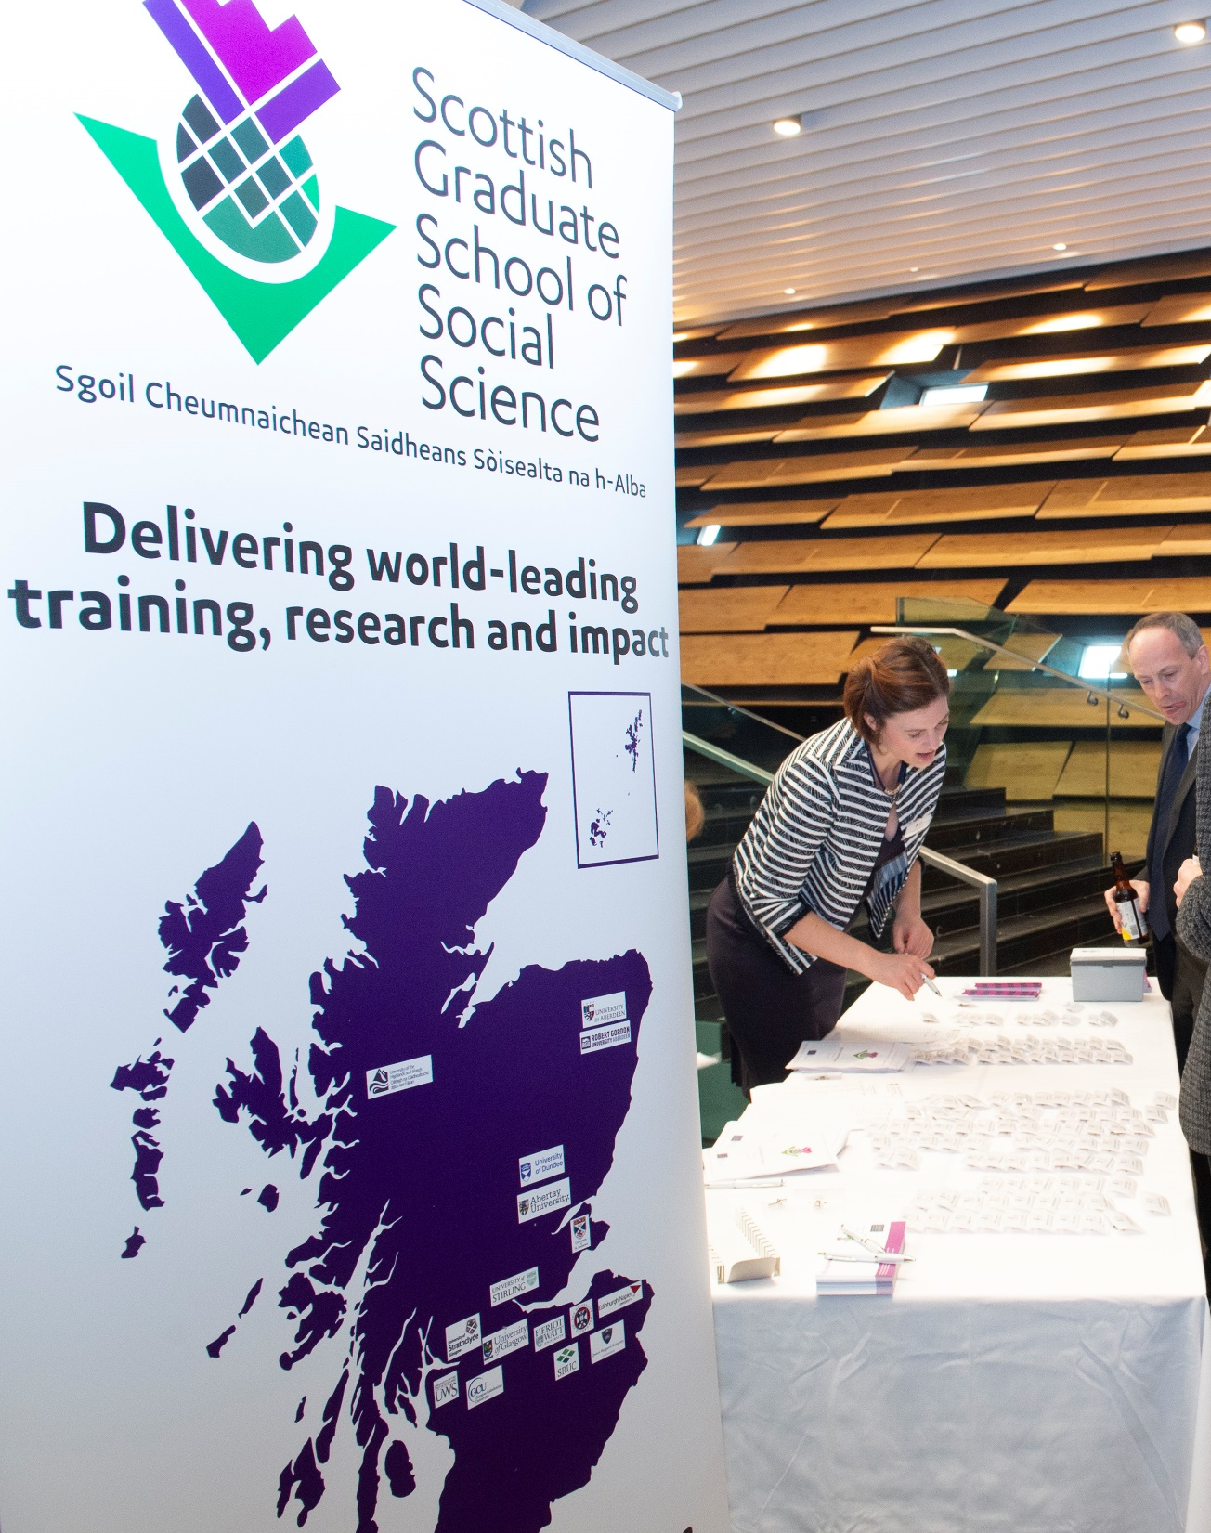
What will we cover?
A brief introduction to DTP2 and its implications for supervisors
A brief introduction to our SDS Competition Timeline.
Overview of the SDS Topics (presented by Emma Hollywood)
Time for Q&A

Slide 3
Supervisor-led Studentships
Key changes for DTP2
Major change in ESRC Completion Policy for students commencing from October 2024: completion within the funded period.
  Risk assessment and feasibility key in devising, assessing and implementing research proposals
The length of the standard PhD has increased to 3.5 years in recognition of ESRC expectations that students will undertake a 3ms placement (more later) and 3 months for additional new training required by the ESRC. (A reminder that all studentships must be offered as full-time or part-time opportunities).
Eligibility for first supervision - First supervisors need to be research-active social scientists who are aligned to a UoA for which their institution has eligibility. SGSSS (and ESRC) will audit supervisor eligibility carefully. For more on eligibility criteria, visit this page.

Slide 4
Supervisor-led Studentships
Key changes in DTP2
Move to challenge-led pathways: each applicant must select a challenge-led pathway within which their student will sit.
Communication, AI, and New Technologies​ | Environment, Migration, and Demographic Change​
Governance and Institutions​ | Health, Wellbeing and Communities ​
Securities: Justice, Economies, and Conflict​ | Social Inequalities​

Slide 5
Supervisor-led Studentships
Introducing “Research in Practice”
Through Research in Practice, SGSSS seeks to equip ESRC funded students to be confident collaborating across sectors and disciplinary boundaries.
The placement must be separate to the PhD student’s research and be designed to support their researcher development, sector knowledge and transferable skills.
Students must undertake the placement in the second or third year of their PhD study, with more than 3 months remaining before their funding end date.
Placements can take place within academia or outside academia.
Academic placements must not be undertaken with the student’s current supervisor and/or research team.
Placements must provide opportunity to apply their research skills in new environments
Students will discuss placement plans with their supervisor team and SGSSS at the Development Needs Analysis.
SGSSS must approve all placement proposals in advance to confirm that they meet the placement requirements.
For more on placements, click here.

Slide 6
Supervisor-led Studentships
Key notes for new supervisors
In 2021 we introduced a new element to our marking Framework – the Whole Person Approach – all successful applicants to our supervisor led competitions will be expected to use this in recruiting students – you will receive guidance on this following our panel decisions.
In 2020 the ESRC changed its recruitment policy on international students – we are now able to recruit international students up to a maximum of 30% of our total allocation. This is complex to implement across competitions and so successful supervisors will receive guidance on recruitment.

Slide 7

Supervisor-led Studentships
There are three separate competitions
Dates for your diary
15th October: Deadline
for Collaborative Competition and SDS Collaborative Competition Applications
Steers Competition
3 awards in each of the following steers
Advanced Quantitative Methods
Dataset
Interdisciplinary
'Open' Collaborative Competition
~15 awards
Skills Development Scotland Collaborative Competition
Up to 3 awards
Please note institutions may set their own internal deadlines

Slide 8
Key tips for securing funding​
Our review will include evaluations by academics outside the discipline area of the student/supervisor​
So, there is a need to communicate clearly the logic, value and broader impact of the research to colleagues in other disciplines​
Consider the wider social/economic/academic contribution of the thesis. Can you link these to ESRC strategic ambitions? Look at PhDs funded by ESRC
The ESRC requires PhD research to be completed in 3 years (no writing-up year)​ - Our evaluation of applications will consider the feasibility of PhD projects carefully​ - consider elements like data access/preparation, overseas elements
Use the ‘risks’ section of the application form to explain contingency planning in the event of delays in order to maintain ambition in the proposal
Develop a collaborative application with the collaborative partner

Slide 9
Key tips for securing funding​
Pay close attention to the scoring criteria (reviewers are trained to use this)
Supervision and training – be specific and think beyond research skills to other things that will be useful to develop a student to thrive in and beyond the PhD (dissemination, ethics, wellbeing, engagement with policymakers). Consider supervisor development needs.
There is strong competition……. We do welcome re-submissions and we do provide feedback

Slide 10

Skills Development Scotland
Dr Emma Hollywood
Dr Emma Parry

Slide 11

SDS Collaborative PhD Programme
Aims of the SDS PhD Programme
To build strong relationships with the academic community.
Create a cohort of future research leaders with a deep understanding of the skills system in Scotland.
Deliver research outputs and insights which are academically rigorous, with a strong policy and practice focus to inform SDS and the wider skills system.
Find out more in our 2025/26 PhD Brochure
How it works
SDS identifies topics that will contribute to our strategic objectives
SDS works closely with the academic supervisors and the student to support successful completion of the PhD
Up to three proposals are awarded each year, co-funded by SDS and SGSSS
The PhD should have a strong focus on policy and practice outcomes that are relevant to SDS

Slide 12
Working with SDS
SDS offer
Provide an SDS sponsor
Knowledge exchange programme of seminars, Networking Event, student competitions
Placement opportunities
Access to SDS research findings and respondents
Role of student
Students work closely with SDS from the start
Monthly meetings with SDS sponsor
SDS sponsor, student and supervisor meet at least once a year
Keep SDS up to date with any changes or issues

Slide 13
What makes a successful SDS collaborative proposal
Knowledge and understanding of what SDS does as an organisation
Alignment with our strategic focus as an organisation and ‘sphere of influence’
Strong commitment to working with SDS throughout the duration of the studentship and with the SDS sponsor
Supporting the PhD student to develop the policy and practice elements of their research
SDS is always keen to speak to prospective supervisors about the focus and relevance of their application

Slide 14
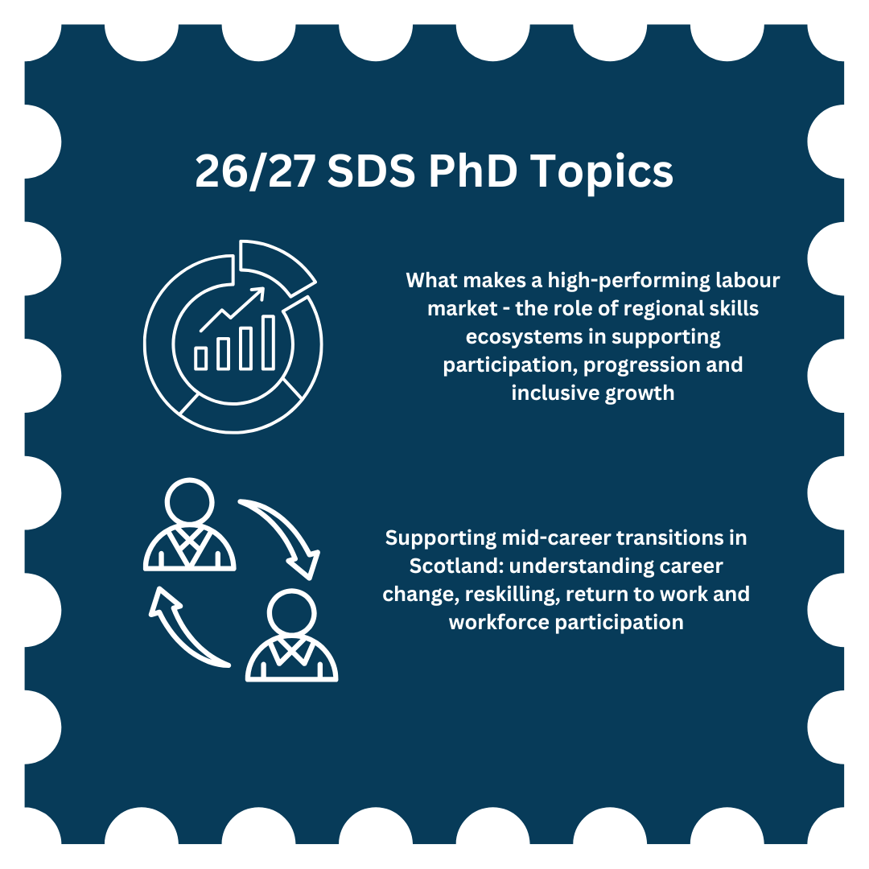
26/27 SDS Topics

Slide 15
SDS Competition Timeline
Competition Launch
15 October, 5 pm (Thursday) | Deadline for applications via SGSSS Apply
Outcome of Competition
04 December, by 5pm (Friday) | SGSSS to communicate the outcome of the Competition to all applicants (successful and unsuccessful), confirming awards

Slide 16
Q&A
If you have any additional queries, please email us on team@sgsss.ac.uk

